Slide 2
Objectives over the next 3 years
Strand 1
Strand 2
2000
1000
Train 2000 professionals and trusted adults on opportunities and risks for YP on social media
Support 1000 young Londoners (16-30) into digital training and careers
Notes:
The social switch is switching the narrative on how young people engage with social media / online

Slide 3
Strand 2 – Young People Employability

Slide 4
OVERVIEW
The SSP aims to support underrepresented groups into careers and training in the digital and tech industry
WHO’S IT FOR?
Age – 16 – 30 year olds
Location – London
Length – Up to 6 months inc. in work support
Employment status - Participants can be unemployed, under employed or looking for something new
WHAT DO PARTICIPANTS GET?
Tailored journey by selecting from our menu of support HERE
Funding for devices, courses, PPE, transport and much more
Work Experience and mentoring opportunities
E-learning short courses inc. Intro to self employment, digital marketing, coding
Training on online safety and gender-based violence
Screening for Neurodiverse conditions to better inform direction of support from Genius Within

Slide 5
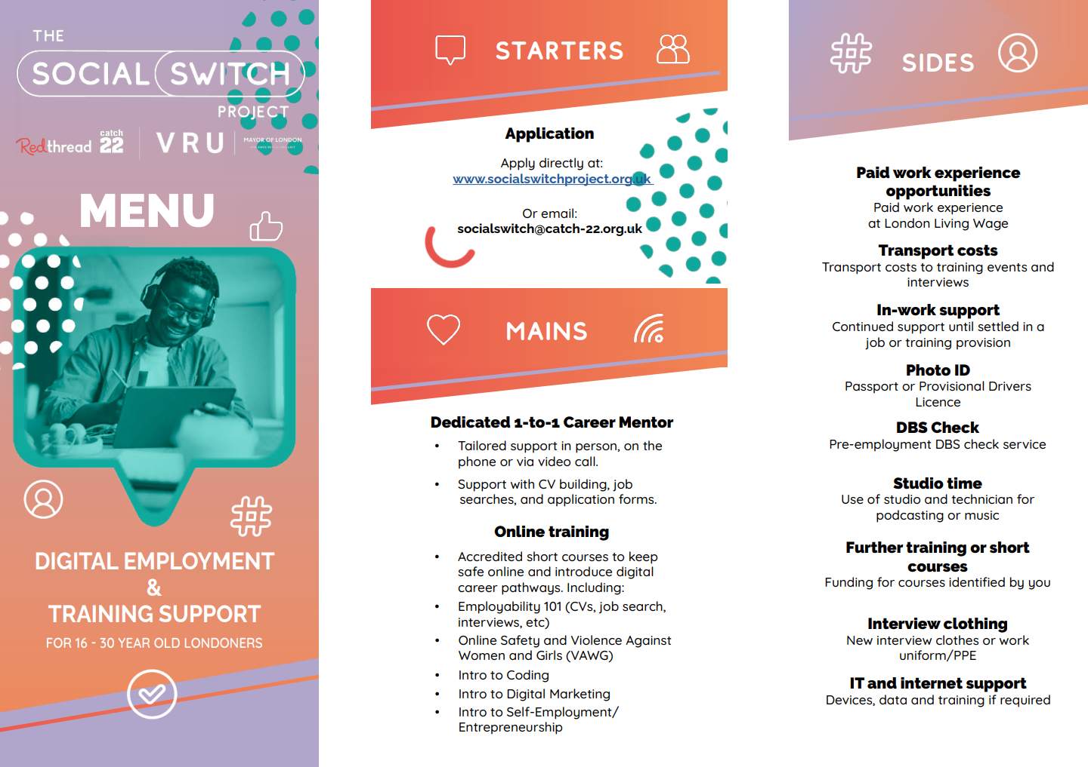

Slide 6
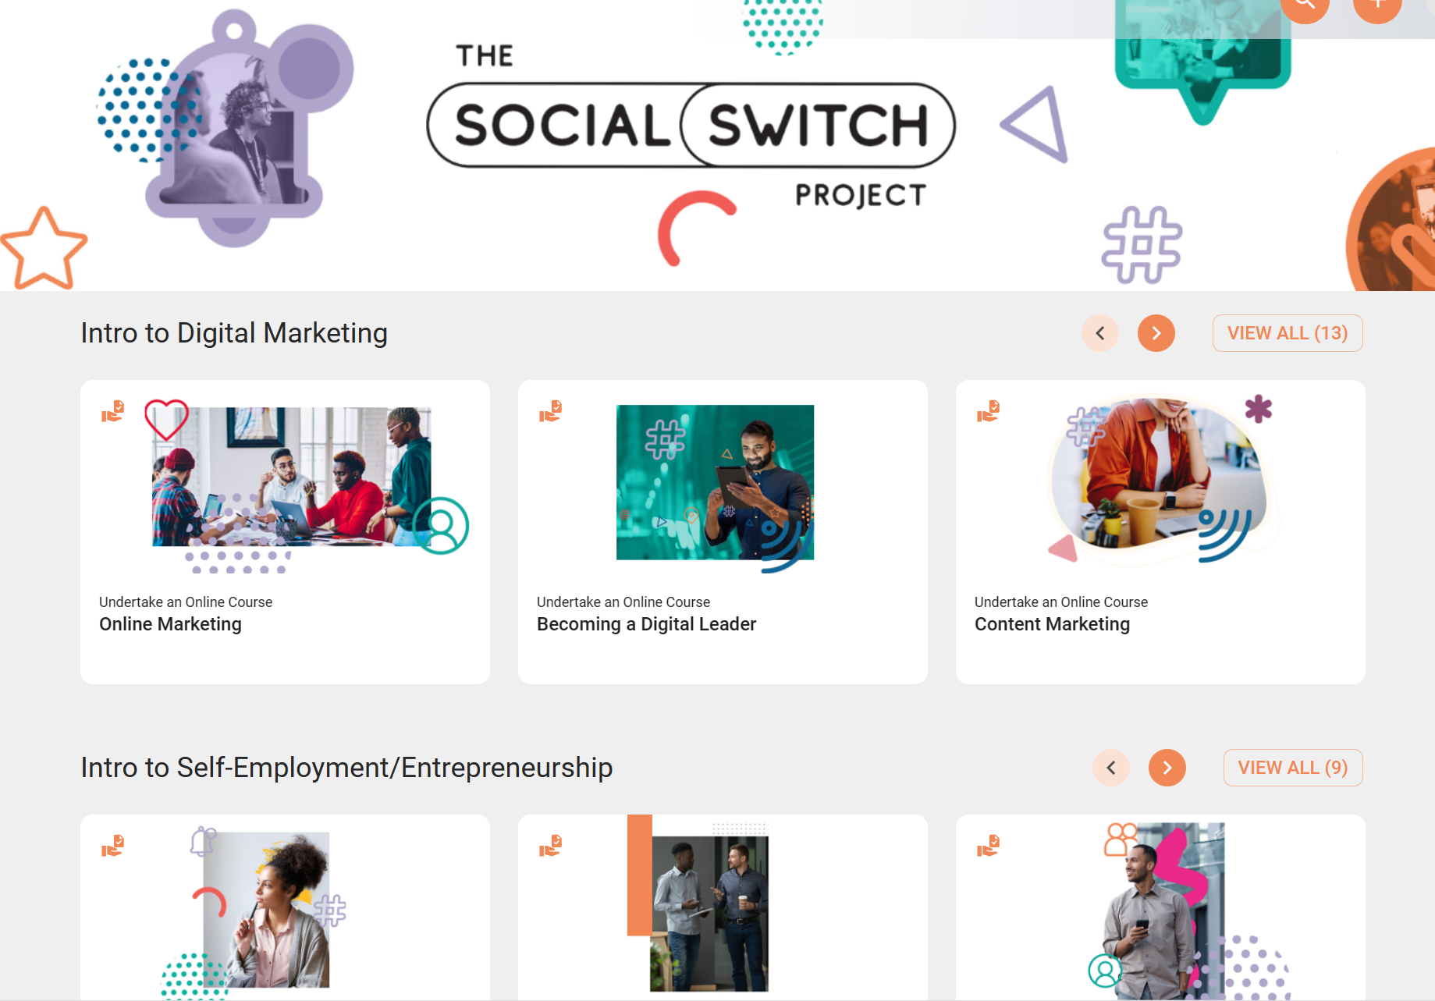
Notes:
We are currently partnering with Learning Pool an online e-learning platform. And we are due to launch this in the coming weeks to give access to employability training and courses for our services.

Slide 7
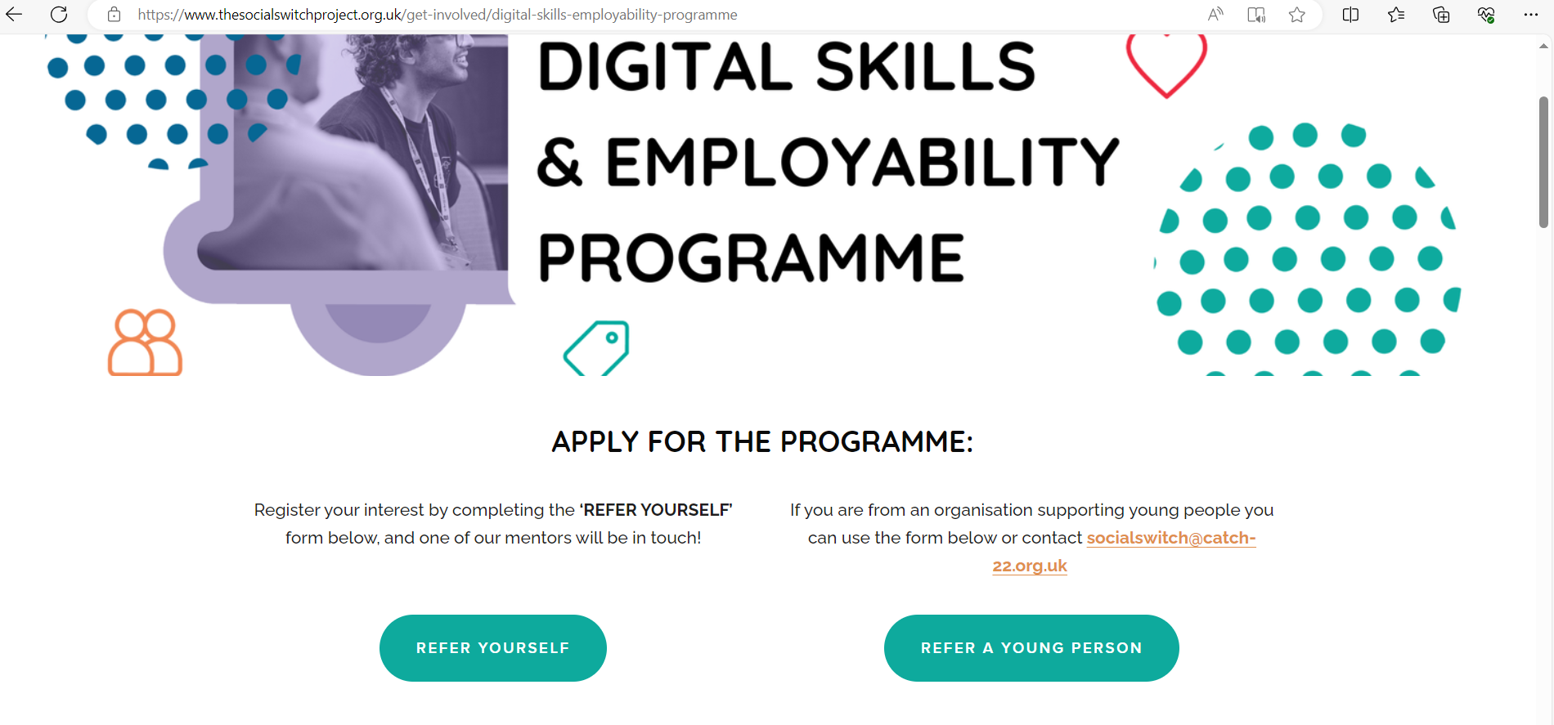
Application via www.thesocialswitchproject.org.uk

Slide 8
Strand 1 – Upskilling Professionals and Trusted Adults

Slide 9
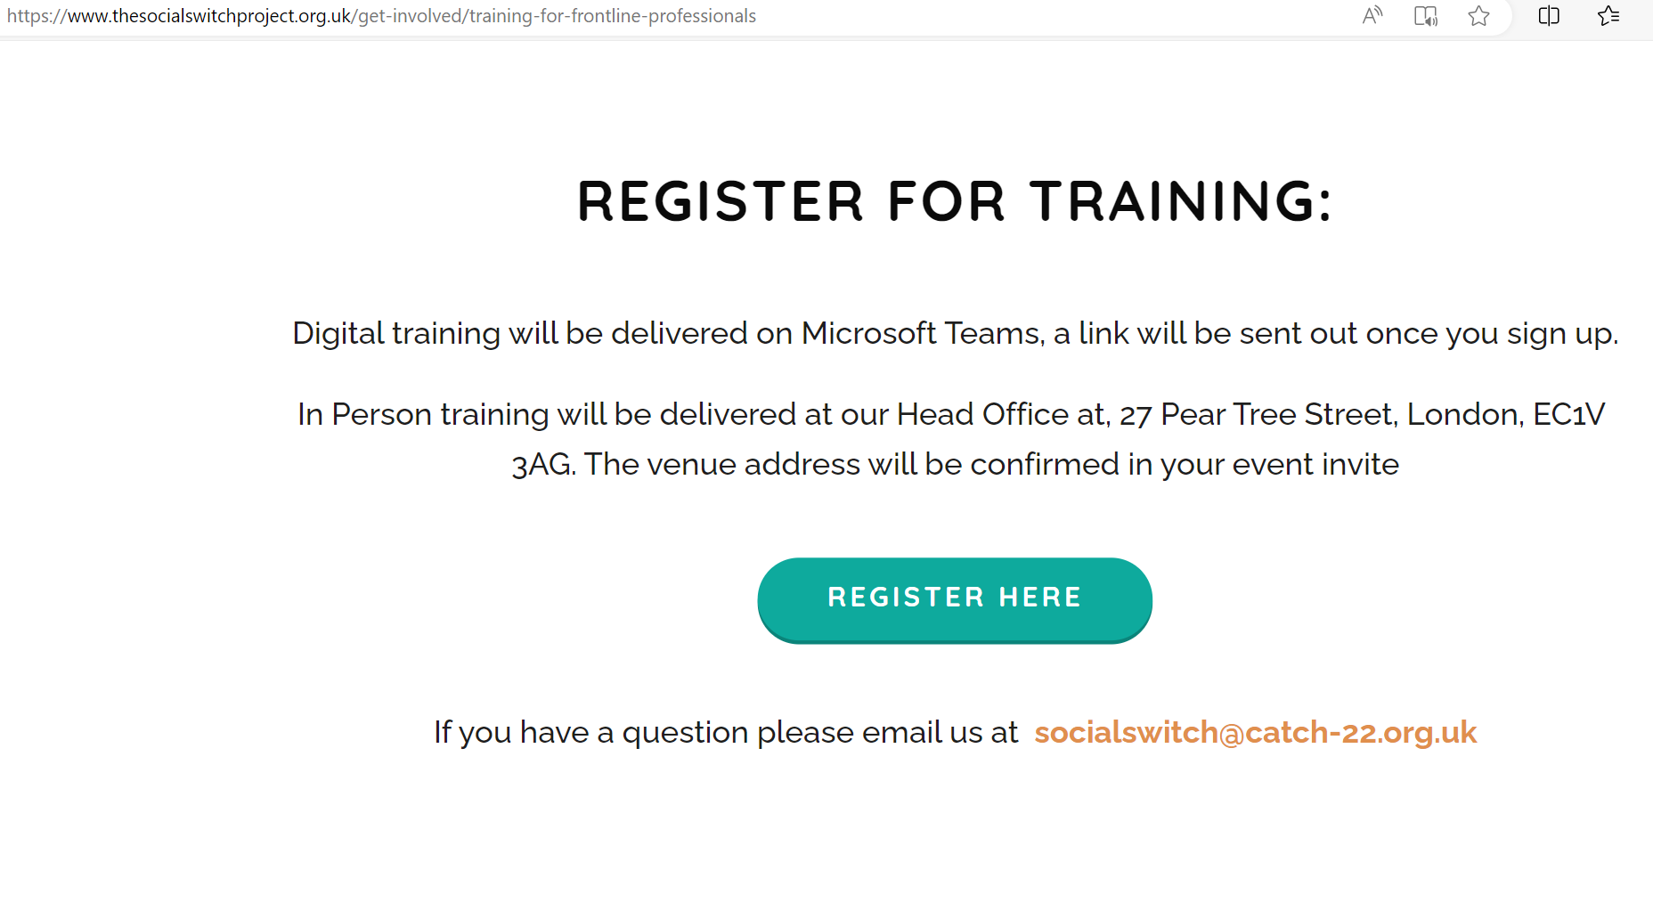
Application via www.thesocialswitchproject.org.uk
Notes:
We’ve got new dates for the new year. We also have in-person and online training for this – there’s a hybrid option for what suits you best. There’ll be upcoming sessions for trusted adults and parents.

